Slide 1
SDN – Firewall ACL Application
Project Short Description:
Implementing Security - access control rules between the hosts
Submitted by group A:
Margarita Tsekvava
Vishal Padwal
Vipul Popat

Slide 2
USED TECHNOLOGIES
Mininet
OpenFlow
RYU Controller
Python

Slide 3
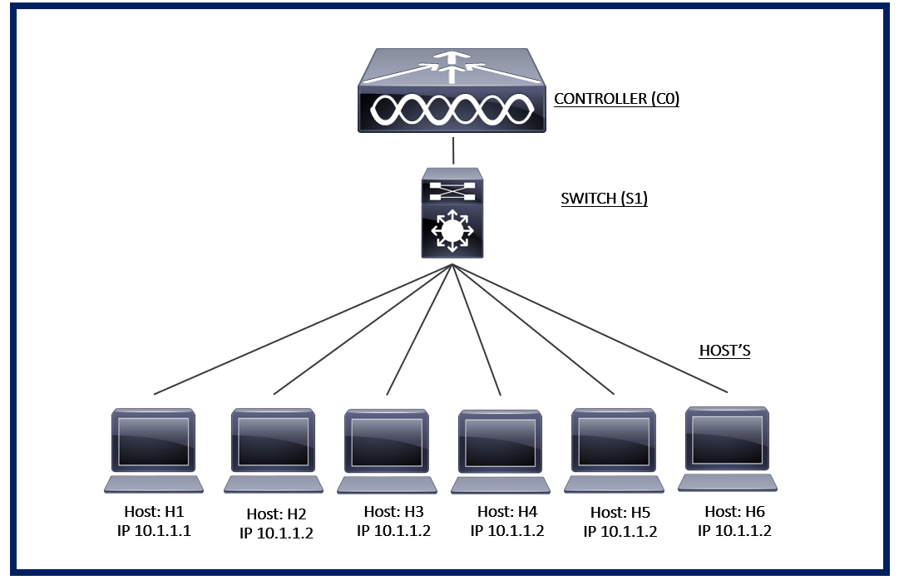
Topology

Slide 4
Objectives
Allow/Deny the traffic between the hosts based in the Access control list (ACL) rules configured
Show wild card level access list: word “any” – is used for wildcard
IP Level Access Control Management
Allow traffic from “Source IP” to “Destination IP”
Allow traffic from “Source IP” to any “Source IP”
Allow traffic from any “Source IP” to a specific “Source IP”
Protocol Level Access
ICMP
TCP with source/destination port number
UDP with source/destination port number

Slide 5
THANK YOU FOR YOUR ATTENTION!

